Slide 1
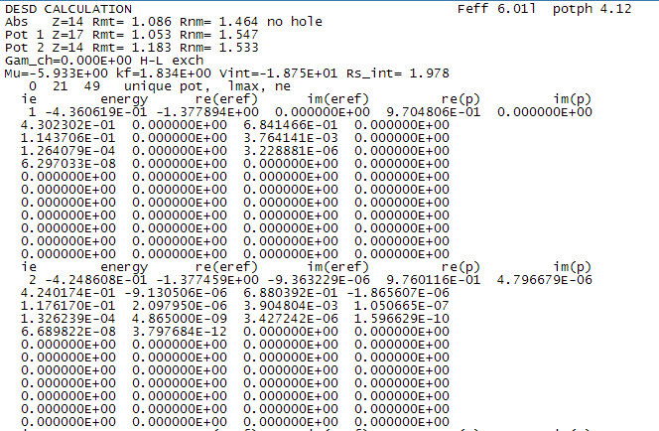
subroutine wphase (nph, em, eref, lmax, ne, ph)
c Writes phase data to file PHASExx.DAT for each shell
Abs = Absorber
Z = atomic number
Rmt = muffin-tin radius, in Bohr radii

Slide 2
kf = fermi momentum at avg interstitial charge density
mu = total absorption cross-section
200 format('Mu=',1pe10.3, ' kf=',1pe9.3, ' Vint=',1pe10.3,
x ' Rs_int=',0pf6.3)
write(head(nhead),200) xmu*ryd, xf/bohr, vint*ryd, rs
Since vint *ryd, and ryd is defined in the code to be 13.605, and 1Ry = 13.605 eV, therefore what is output as Vint in the Phasexx file seems to be eV.
I also believe that eref is the complex Vint (including voptical) in Ry.
c kf = fa/rs with fa = (9*pi/4)**third, see Ash&Merm, pg 37
c note that vint includes both coulomb and ground state
c exchange-correlation potentials
Xmu = Fermi level

Slide 3
SpeciesID, maxL, number of energy points
c igamma added to the reference so that k^2 = E - Eref, where
c Eref = Vat(mt) - igamma / 2
eref = eref - coni * gamach / 2
c Add const imag part
eref = eref - coni * vi0
k^2 = E - Eref
xp = sqrt(em(ie) - eref(ie))
write(1,246) ie, em(ie), eref(ie), sqrt(em(ie)-eref(ie))
246 format (' ie energy re(eref)',
1 ' im(eref)',
2 ' re(p) im(p)', /,

Slide 4
Energy is in Rydbergs (check), relative to the edge.
Re(eref), im(eref) are real and imaginary parts of the muffin-tin zero for that incident electron energy.
Eref=interstitial energy ref (complex)
It appears p is momentum or sqrt(E-Eref)
c for each energy
c ie, em, eref, p=sqrt(em-eref)
write(1,246) ie, em(ie), eref(ie), sqrt(em(ie)-eref(ie))
246 format (' ie energy re(eref)',
1 ' im(eref)',
2 ' re(p) im(p)', /,
3 1x, i4, 1p, 5e14.6)

Slide 5
Phase shifts for l = 0, l = 1, etc. Units are Radians. Format is
(l=0 Re) (l=0 Im) (l=1 Re) (l=1 Im)

Slide 6
http://leonardo.phys.washington.edu/feff/wiki/index.php?title=EXCHANGE

